Slide 1

Kaya
Suet
Kenneth

Slide 2
Group Name: c23-bad-project-03-tw
Member List: Kaya Suet Kenneth
Topic: Mood Tracking - Frame of Mind
Description:
Frame of Mind is a mood tracker app built for people with bipolar disorder. Users will be able to log and track their mood on calendar by using emoticon, diary and voice detection.
Tech Stack: Typescript, Restful API, NodeJS, PostgreSQL, GitLab CI/CD, AWS (Route 53, EC2), AJAX, Bcrypt.JS, Express.js, CSS, Express Session, HTML, Knex, PostgreSQL, Migration and Seeds, Prettier, Socket IO, CV2, Python (Request), Python(Flask), Jest, Winston,

Slide 3








Tech Stack
Typescript, Restful API, NodeJS, PostgreSQL, GitLab CI/CD, AWS (Route 53, EC2), AJAX, Bcrypt.JS, Express.js, CSS, Express Session, HTML, Knex, Migration and Seeds, Prettier, Socket IO, CV2, Python (Request), Python(Flask), Jest, Winston,

Slide 4
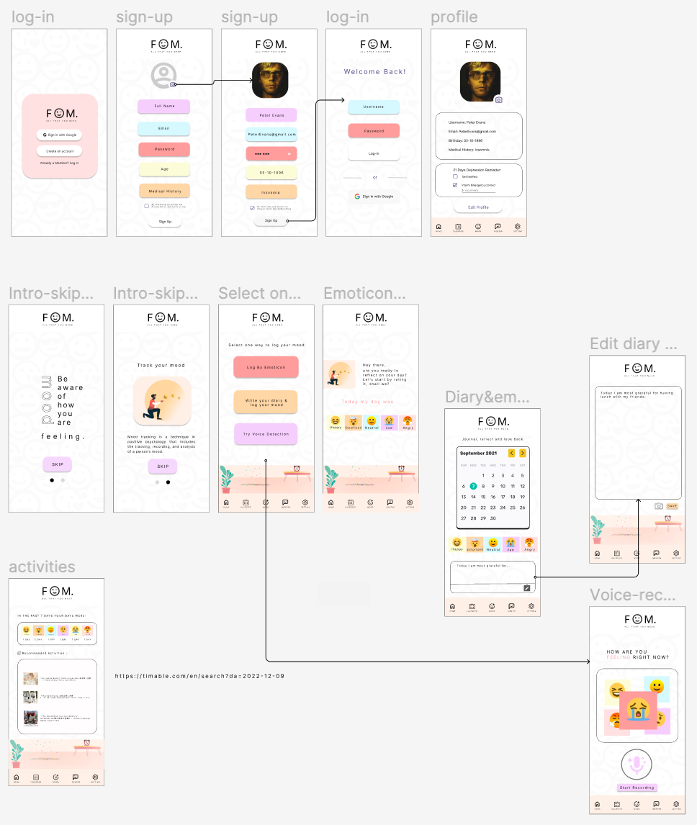
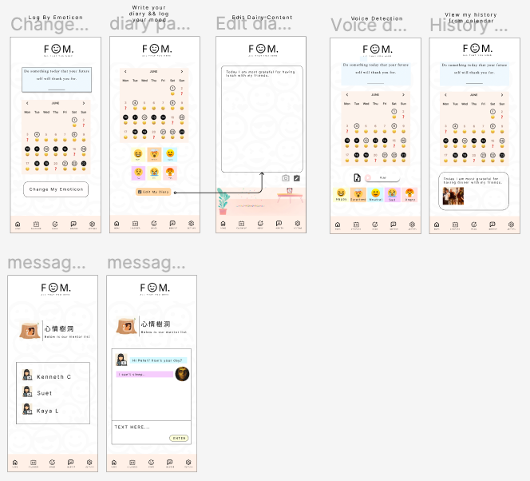
git checkout production
Wireframe

Slide 5
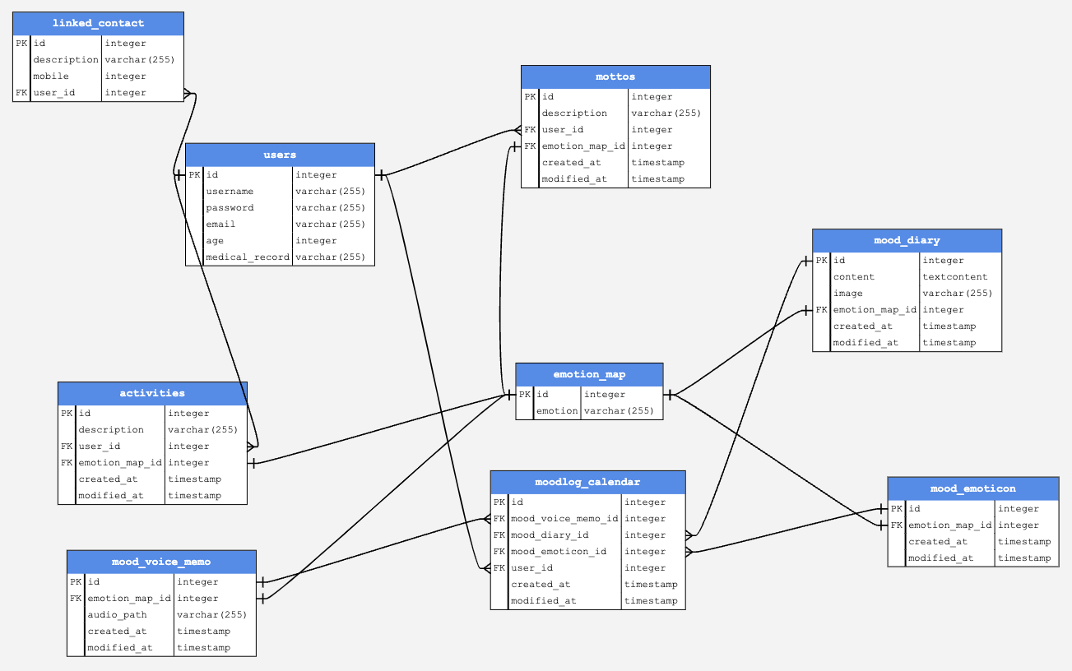
ERD

Slide 6
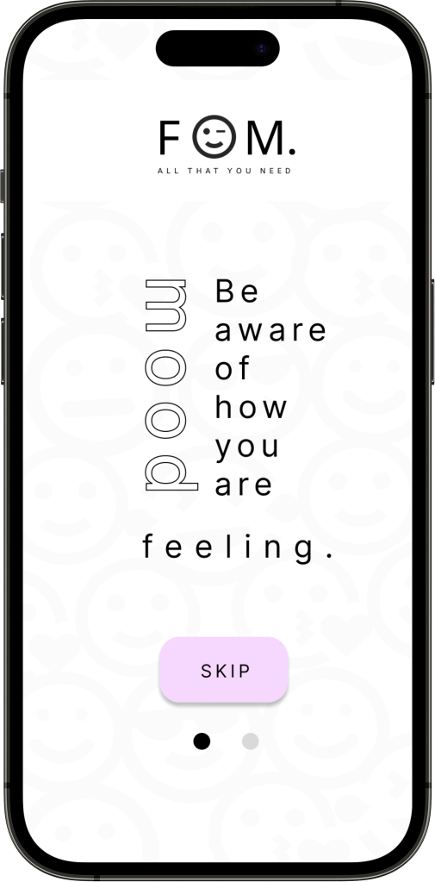
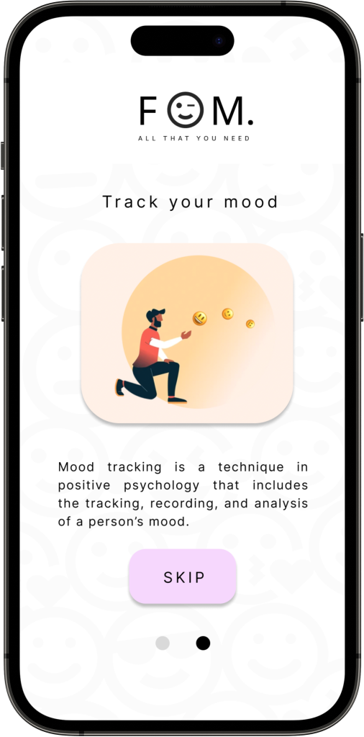
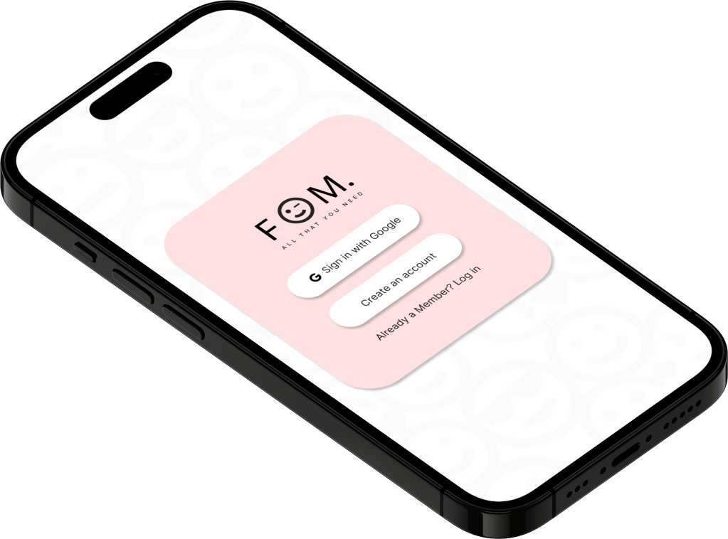
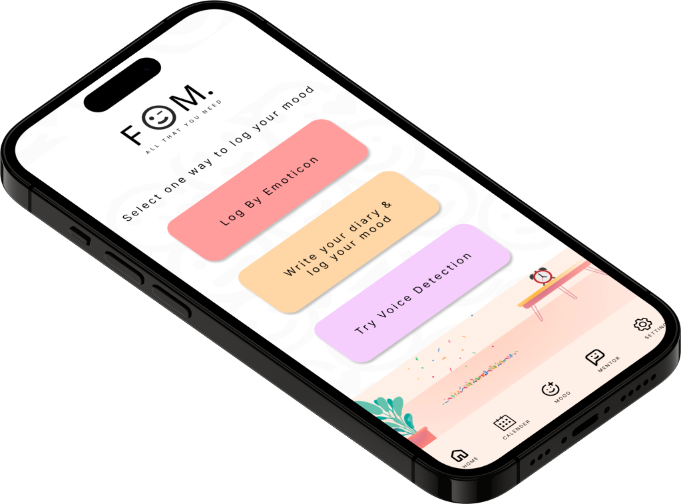
Wireframe

Slide 7
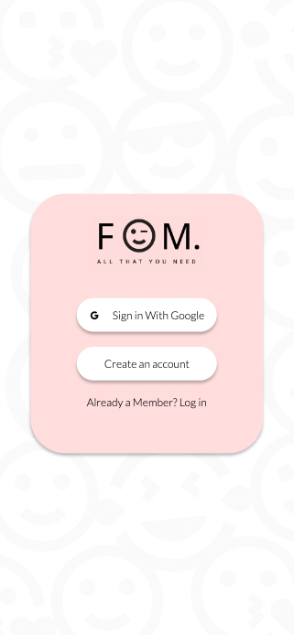
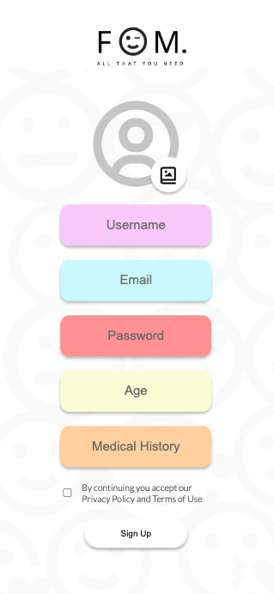
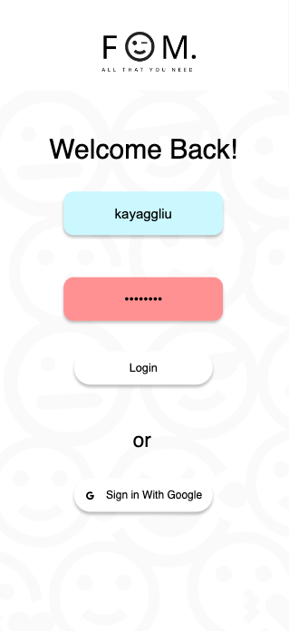
Login & Sign up account

Slide 8
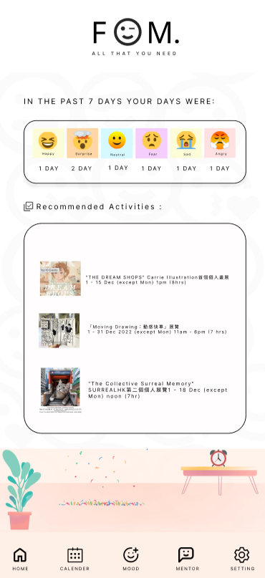
Home
Statistics return the mood of the past 7 days
Recommended activities according to the mood of the past 7 days

Slide 9
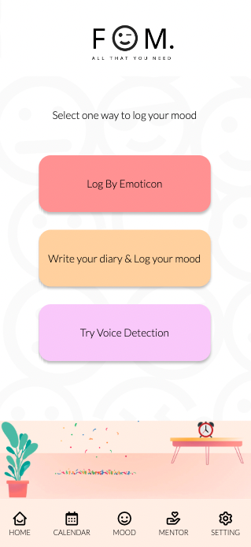
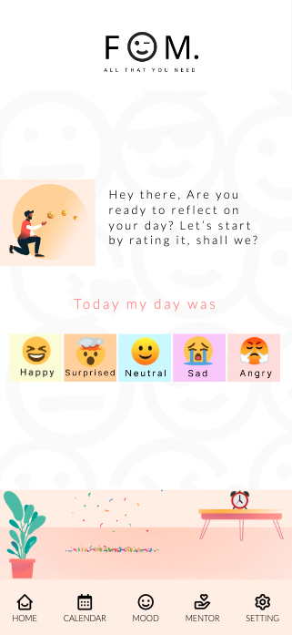
Mood
Log By Emoticon

Slide 10
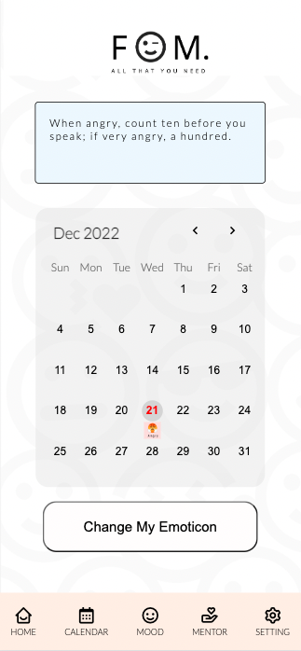

Calendar
Select by emoticon
Click on “Change my emotion”
=> will redirect to the page to re-select emoticon
Save to calendar

Slide 11

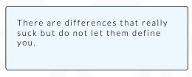


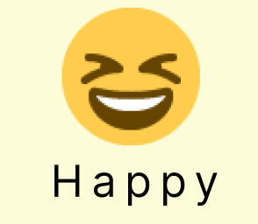

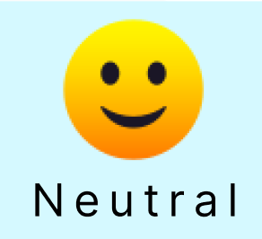
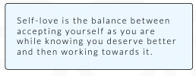
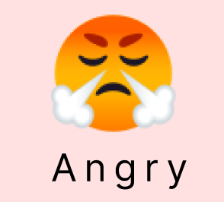

Calendar
Select by emoticon
Mottos will be randomly generated depends on the emoticon to be selected

Slide 12
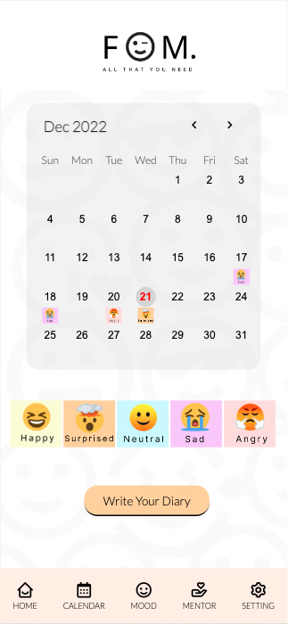
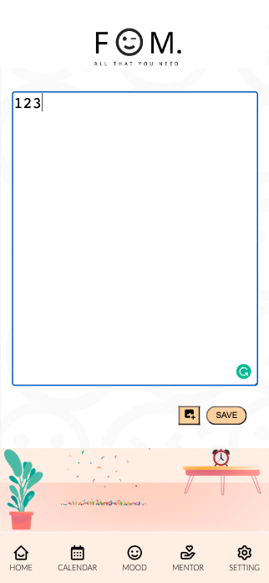
Mood
Log by emoticon
& Write by diary

Slide 13
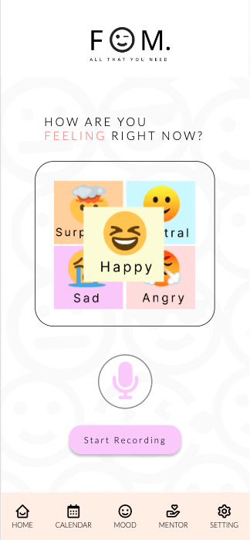
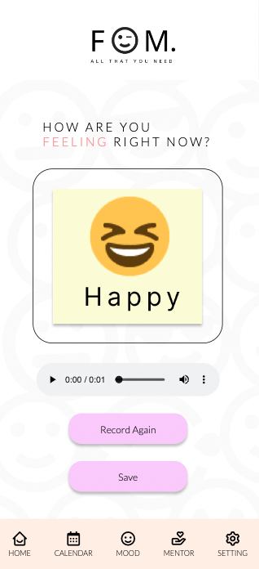
Mood
Try Voice Detection

Slide 14
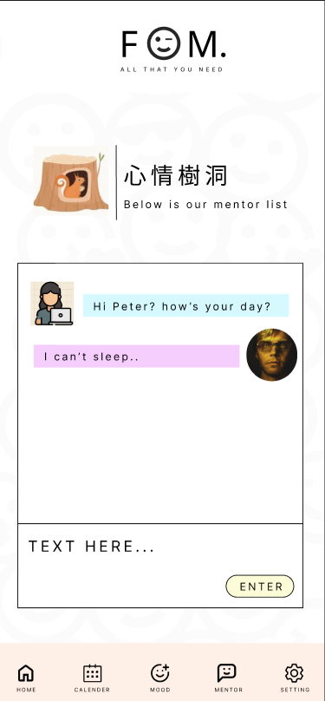
Mentor
Chat with other online client

Slide 15
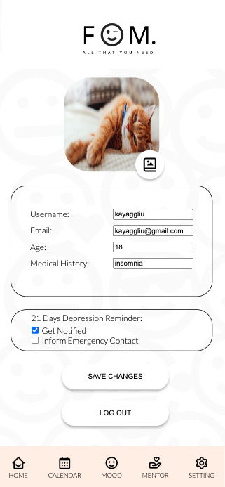
Profile

Slide 16
THANK YOU !

